Slide 1
Assessment of Forecasting Strategies on Univariate Time Series Data
IIT2016039 Sai Charan Teja
IIT2016040 Anmol Singh Sethi
IIT2016042 Manavdeep Singh

Slide 2
Introduction
Time Series: A time series is a series of data points indexed in time order. Most commonly, a time series is a sequence taken at successive equally spaced points in time.
Load Forecasting: Load forecasting is a technique used by power or energy-providing companies to predict the power/energy needed to meet the demand and supply equilibrium
Need: Accurate models for electric power load forecasting are essential to the operation and planning of a utility.
Types: Very Short term load forecasting, Short term load forecasting, Medium term load forecasting, Long term load forecasting
Benchmark Models: Auto Regression(AR), Moving Averages(MA), Auto Regression Integrated Moving Averages(ARIMA), Auto Regression Moving Averages(ARMA), etc.

Slide 3
Problem Statement
Using a Non-Conventional Technique - Long Short Term Memory (LSTM) on Univariate Time Series data from different sources and compare the findings with benchmark models like Auto Regression(AR), Auto Regression Integrated Moving Averages(ARIMA) to predict Electricity Load demands. Where Auto Regression and Auto Regression Integrated Moving Averages are statistical models for time series data, LSTM is a machine learning approach to the same.
To validate the output of LSTM model in a generic way, we have taken 5 different data-sets and made expansive experiments to determine an efficient method of solving the problem of Electricity Demand Load Prediction.

Slide 4
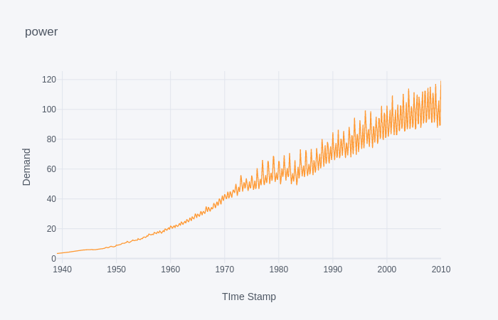
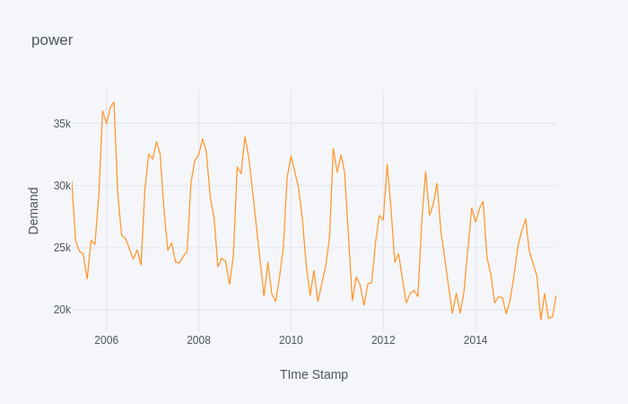
Data Sets Used
FRED ECONOMIC DATA
Data set for industrial production provided by Board of Governors of the Federal Reserve System US. It has monthly frequency.
OPEN POWER SYSTEM DATA
This is a time series data-set giving load, wind and solar, prices in hourly manner. The data is available for 37 European countries. It is provided by Open Knowledge Foundation. Column used is GB_EAW_load_actual_tso
Fig: FRED Data
Fig: OPSD Data

Slide 5
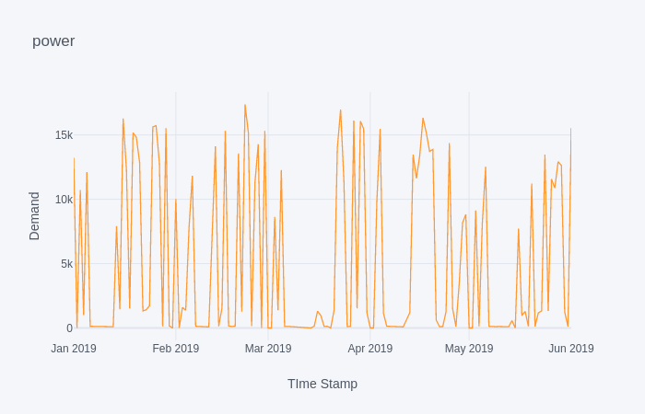
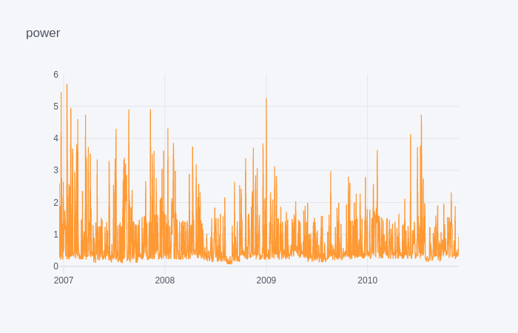
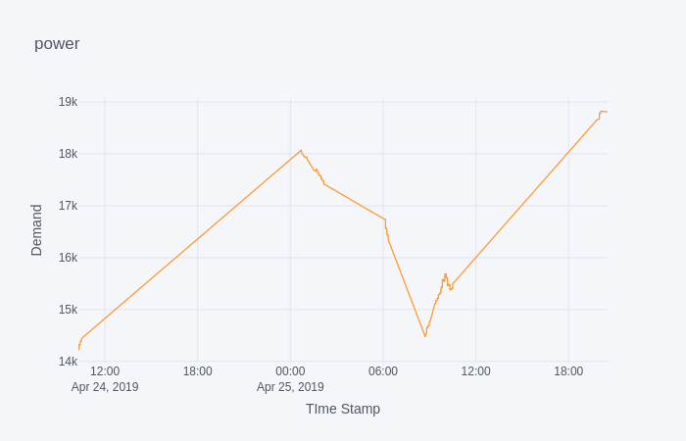
SMARD
A data set provided by Federal Network Agency, Germany, contains the electricity market data. The frequency of the data is daily. The data set contains the value of load for every 15 minutes per day.
UC, IRVINE DATA
hedata-set contains 2075259 instances for one household with one minute sampling located in France for a period of 47 months. Nearly 1.25 percent of the values are missing in the data-set.
UTTAR PRADESH STATE LOAD DISPATCH DATA
This is a real time data provided by Uttar State Load Dispatch Centre. The data has been web-scrapped for a period of 1 day.
Fig: SMARD Data
Fig: UCI Data
Fig: UPSLDC Data

Slide 6
Literature Review
Short Term Load Forecasting Using Time Series Analysis: A Case Study for Karnataka, India, Nataraja.C, M.B.Gorawar, Shilpa.G.N., Shri Harsha.J, 2012
development of Short Term Load Forecasting Models Using Time series Analysis for Karnataka Demand and hence comparison of different models, such as AR, ARMA, ARIMA, with errors of 13.03%, 11.03%, 6.15% respectively.^{[3]}
Study & Development of Short Term Load Forecasting Models Using Stochastic Time Series Analysis, V.Venkatesh, Shilpa G N ,Nataraja.C, 2014
study & development of various time series models for Short Term Electrical Load Forecasting Using Time series approach. one year load data, first six months data is used for model development. The methodology involves Initial Model Development Phase, Parameter Tuning Phase and Forecasting Phase
Comparison of ARIMA and ANN Models Used in Electricity Price Forecasting for Power Market, Gao Gao, Kwoklun Lo, Fulin Fan, 2017
introduces the models of autoregressive integrated moving average (ARIMA) and artificial neural network (ANN) which are applied to the price forecasts for up to 3 steps 8 weeks ahead in the UK electricity market. compared in terms of the root mean square errors (RMSEs) of price forecasts.^{[2]}

Slide 7
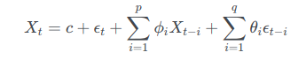
Methodology
STATISTICAL APPROACH:
AUTO REGRESSION
Auto regression is a special type of regression in which prediction of a variable is done with help of the past or previous values of the same variable.
For example we can predict the price of gold annually or we can predict the load of electricity over a period of time based on their previous values.
Price(t+ 1) = a₀ + a₁ ∗ Price(t−1) + a₂ ∗ Price(t−2)
ARIMA
There are seasonal and Non-seasonal ARIMA models that can be used for forecasting.

Slide 8
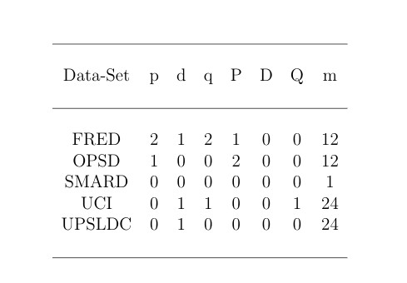
SEASONAL ARIMA
As the name suggests, this model is used when the time series exhibits seasonality. This model is similar to ARIMA models, we just have to add in a few parameters to account for the seasons. We write SARIMA as ARIMA(p,d,q)(P, D, Q)m,
p — the number of autoregressive terms
d — degree of differencing
q — the number of moving average terms
m — refers to the number of periods in each season
(P, D, Q )— represents the (p,d,q) for the seasonal part of the time series
Parameter values for our ARIMA models

Slide 9
MACHINE LEARNING(NEURAL NETWORKS) APPROACH:
LSTM
LSTM Neural Networks, which stand for Long Short-Term Memory, are a particular type of recurrent neural networks.
LSTM networks have some internal contextual state cells that act as long-term or short-term memory cells.
The output of the LSTM network is modulated by the state of these cells.

Slide 10

LSTM Repeating Module
Our LSTM Pipeline

Slide 11
Implementation Timeline
AUG
SEPT
OCT
NOV
W1
W2
W3
W4
W1
W2
W3
W4
W1
W2
W3
W4
W1
W2
W3
W4
LITERATURE REVIEW
STUDY OF LSTM
LSTM IMPLEMENTATION
IMPLEMENTATION OF AR
ARIMA IMPLEMENTATION
COMPARISON AND INCLUSION OF MORE DATASETS

Slide 12
Results

Slide 13
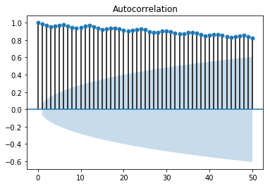
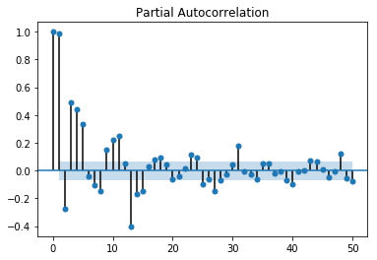
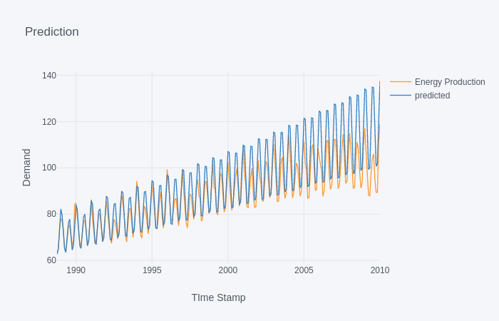
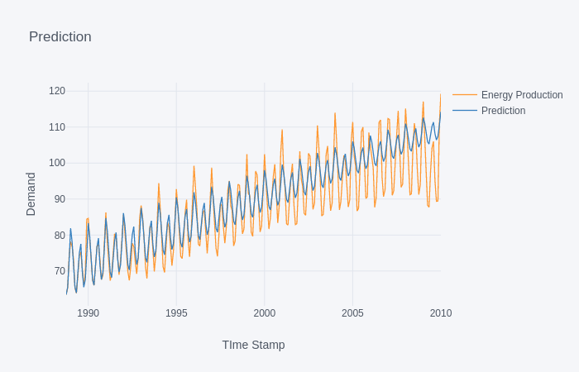
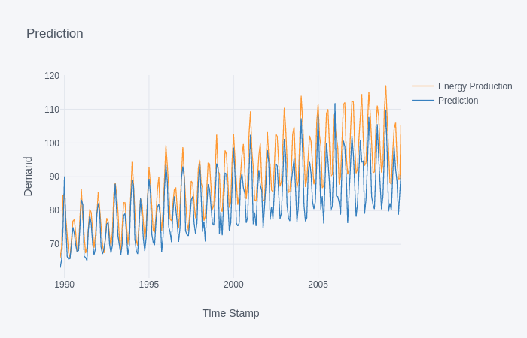
FRED Data
Fig: AR
 | AR | ARIMA | LSTM
RMSE | 8.24 | 5.19 | 7.99
R2 | 0.55 | 0.82 | 0.36
Fig: ARIMA
Fig: LSTM

Slide 14
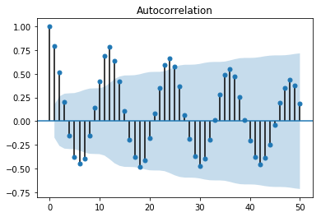
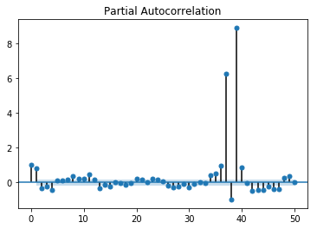
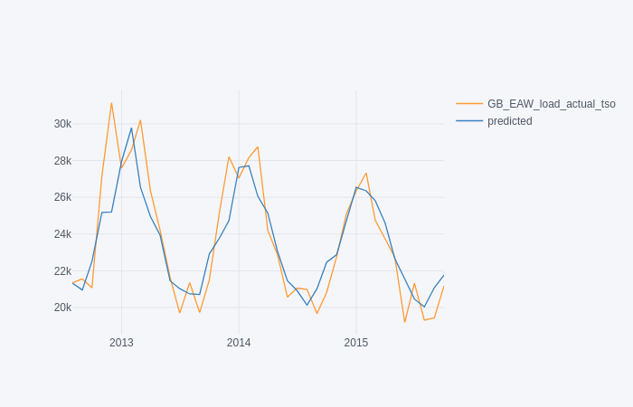
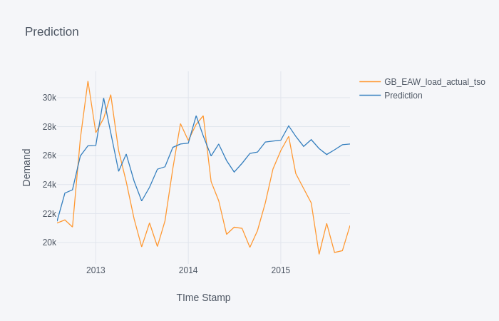
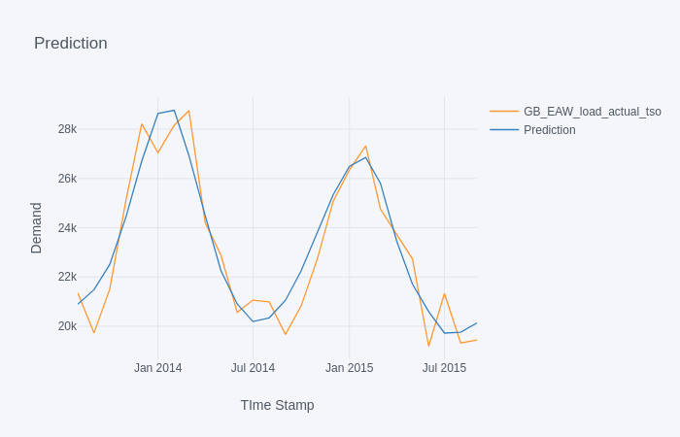
OPSD Data
Fig: AR
 | AR | ARIMA | LSTM
RMSE | 1646 | 3710 | 1035
R2 | 0.76 | -0.21 | 0.86
Fig: ARIMA
Fig: LSTM

Slide 15
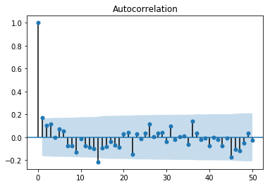
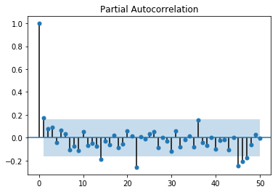
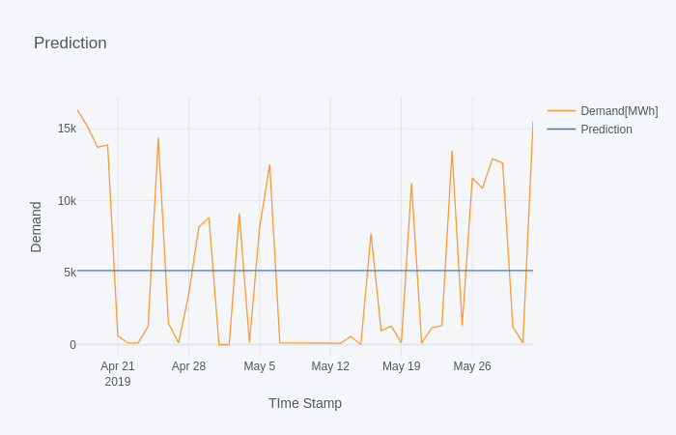
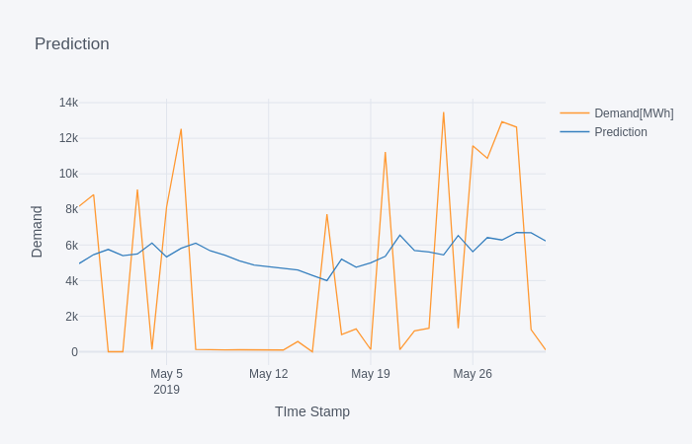
SMARD Data
 | AR | ARIMA | LSTM
RMSE | - | 5864 | 5184
R2 | - | -1.3 | -56.8
Fig: ARIMA
Fig: LSTM

Slide 16
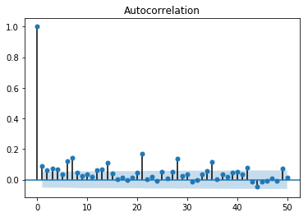
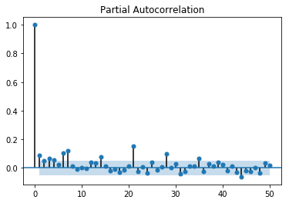
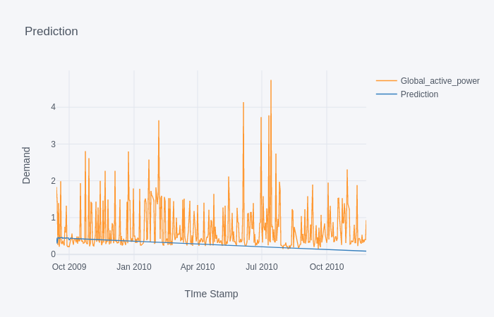
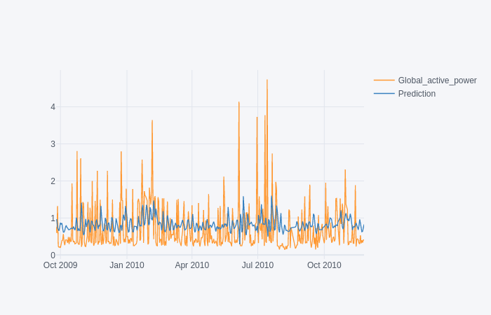
UCI Data
 | AR | ARIMA | LSTM
RMSE | - | 0.78 | 0.65
R2 | - | -0.4 | -13.0
Fig: ARIMA
Fig: LSTM

Slide 17
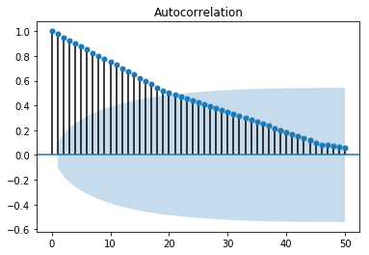
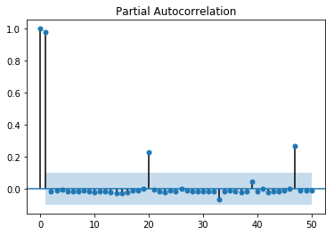
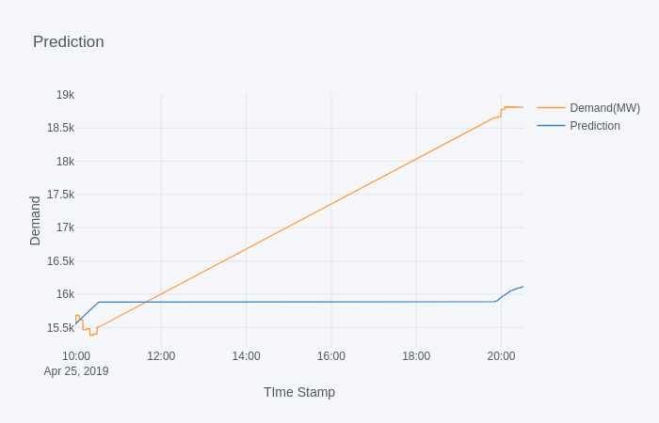
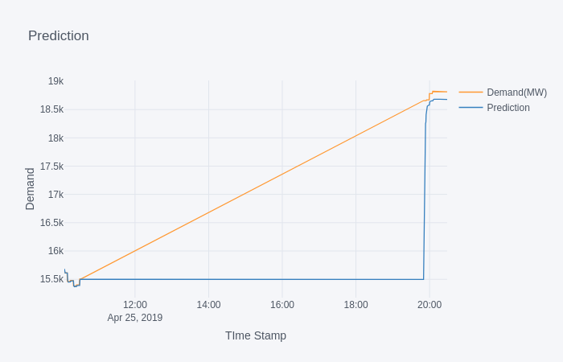
UPSLDC Data
 | AR | ARIMA | LSTM
RMSE | - | 1780 | 334
R2 | - | -0.2 | 0.95
Fig: ARIMA
Fig: LSTM

Slide 18
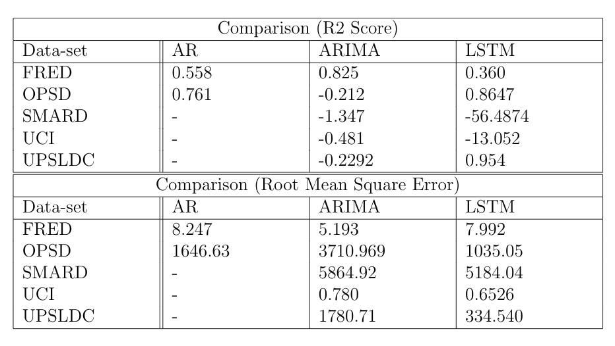
Comparison

Slide 19
Disposal of comments
COMMENT 1: Three different data-sets should be taken
We have used five different datasets for this project.
COMMENT 2: Comparison of LSTM with ARIMA is required
Comparison using two parameters namely Root Mean Square Error and R2 Score have been used. For all data-sets except FRED, LSTM gives a better result as compared to ARIMA. Fred data-set has a very good pattern because of which better results are shown in ARIMA.

Slide 20
References
[1] Nataraja, C. Gorwar, Mahesh Shilpa, G.N. Harsha J, Shri. (2012).
Short term load forecasting using time series analysis: A case study
for Karnataka, India. International Journal of Engineering Science and
Innovative Technology. 1. 45-53.
[2] Gao, Gao Lo, Kwoklun Fan, Fulin. (2017). Comparison of ARIMA and
ANN Models Used in Electricity Price Forecasting for Power Market.
Energy and Power Engineering. 09. 120-126. 10.4236/epe.2017.94B015.
[3] Chikobvu, Delson Sigauke, Caston. (2012). Regression-SARIMA modelling
of daily peak electricity demand in South Africa. Journal of Energy
in Southern Africa. 23. 23-30. 10.17159/2413-3051/2012/v23i3a3169.
[4] Miswan, Nor Mohd Said, Rahaini Anuar, S.H.H.. (2016). ARIMA with
regression model in modelling electricity load demand. 8. 113-116.

Slide 21
[5] Iwok, Iberedem Okpe, A. (2016). A Comparative Study between
Univariate and Multivariate Linear Stationary Time Series Models.
American Journal of Mathematics and Statistics. 2016. 203-212.
10.5923/j.ajms.20160605.02.
[6] Jalil, N.A. Ahmad, Maizah Mohamed, N.. (2013). Electricity load demand
forecasting using exponential smoothing methods. World Applied
Sciences Journal. 22. 1540-1543. 10.5829/idosi.wasj.2013.22.11.2891.
[7] \Load Forecasting Bibliography", Phase I, IEEE Transactions on Power
Apparatus and Systems, Vol.PAS-99, No.1 January/February 1980.
[8] Short term load forecasting using time series modeling with peak load
estimation capability", IEEE Transactions on Power Systems, Vol.16,
No.3 August 2001
[9] Hippert, H.s Pedreira, Carlos Souza, Reinaldo. (2001). Neural Networks
for Short-Term Load Forecasting: A Review and Evaluation.

Slide 22
[10] Load forecasting using support vector machines: A study on EUNITE
competition 2001", IEEE Transactions on Power Systems, Vol.19, No.4,
November 2004.
[11] \Short term load forecasting using fuzzy neural networks", IEEE Transactions
on Power Systems, Vol.10, No.3 August 1995.
[12] \Short term load forecasting for fast developing utility using knowledgebased
expert systems", IEEE Transactions on Power Systems, Vol.17,
No.4, May 2002.
[13] \Short term power system load forecasting using the iteratively
reweighed least squares algorithm", Electric power system research,
19(1990) pp.11-12
[14] M. A. Abu-El-Magd and N. K. Sinha, "Short-Term Load Demand Modeling
and Forecasting: A Review," in IEEE Transactions on Systems.

Slide 23
Thanks!

Slide 24
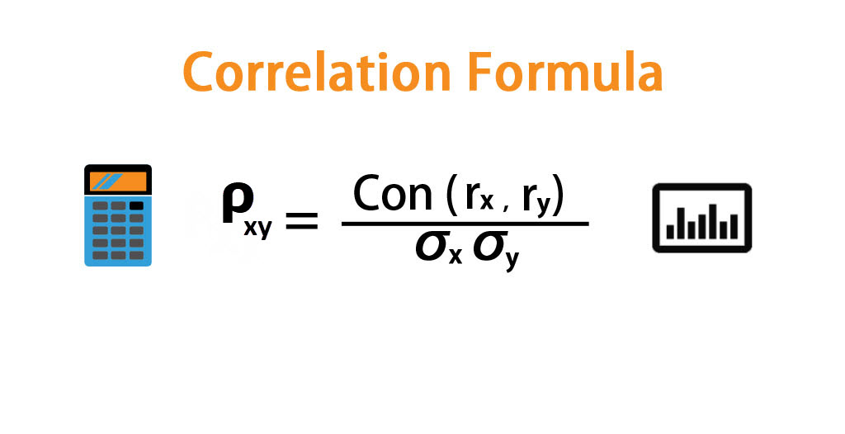
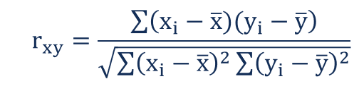
Disposal of comments
COMMENT 1: Three different data-sets should be taken
We have used five different datasets for this project.
COMMENT 2: Comparison of LSTM with ARIMA is required
Comparison using two parameters namely Root Mean Square Error and R2 Score have been used. For all data-sets except FRED, LSTM gives a better result as compared to ARIMA. Fred data-set has a very good pattern because of which better results are shown in ARIMA.

Slide 25
AutoCorrelation Function(ACF)
We can calculate the correlation for time series observations with observations with previous time steps, called lags. Because the correlation of the time series observations is calculated with values of the same series at previous times, this is called a serial correlation, or an autocorrelation. A plot of the autocorrelation of a time series by lag is called the AutoCorrelation Function, or the acronym ACF. This plot is sometimes called a correlogram or an autocorrelation plot.

Slide 26
Partial AutoCorrelation Function (PACF)
A partial autocorrelation is a summary of the relationship between an observation in a time series with observations at prior time steps with the relationships of intervening observations removed.
The partial autocorrelation at lag k is the correlation that results after removing the effect of any correlations due to the terms at shorter lags.

Slide 27
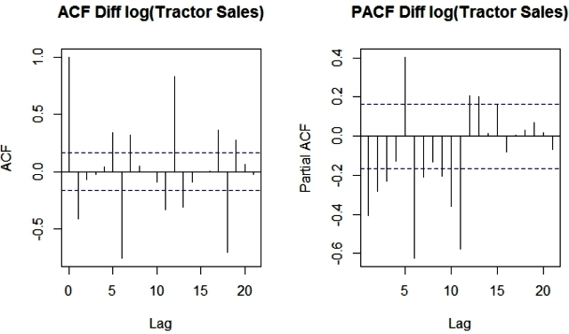
Example -

